Slide 1
epic HEART ADVENTURES
ENDING GLOBAL POVERTY BY 2040
“You may say that I’m a dreamer; but I’m not the only one.
I hope someday you’ll join us, and the world will live as one.”
- John Lennon, Imagine

Slide 2
Mission:
END GLOBAL POVERTY BY 2040
How?
We EMPOWER HUMANITY to LIFT THEMSELVES Out of Poverty
—by UNITING Donor Adventurers—
with the Best Organizations on the Planet
“So powerful is the light of unity
that it can illuminate
the whole earth.”
- Baha ’U’ Llah

Slide 3
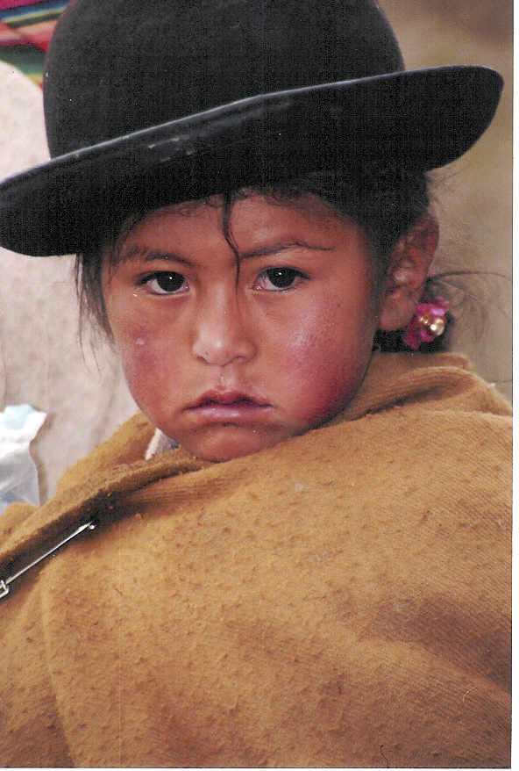
Foundation CORE VALUES
RESPECT
EQUALITY
EMPATHY
SELF IMPROVEMENT
NO JUDGEMENT
“I speak to everyone
in the same way,
whether he [she] is
the garbage man or the president of the university.”
Albert Einstein

Slide 4
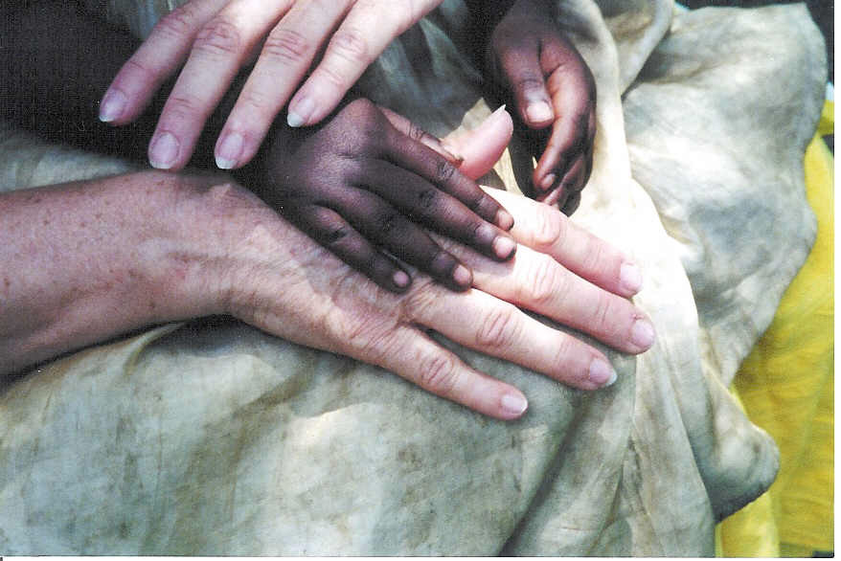
Foundation MANTRA
UNITY IS STRENGTH
Uniting Like-Minded Charities with
Foundations, Corporations, Governments & Individuals to change the world
Collaboration vs. Competition
Non-Restrictive, Broad-Scope, Inclusive
All Worthy Causes Considered
All Like-Minded Organizations Welcome
Leveraging Resources for Optimized Impact
Multiplying Dollars Invested
Screening and Matching Beneficiaries to Donors
Reporting
Visual, Transparent Tracking of Donations
Beneficiaries post photos and results online
“UNITY IS STRENGTH...when there is teamwork and collaboration, wonderful things can be achieved.”
- Mattie Stepanek

Slide 5
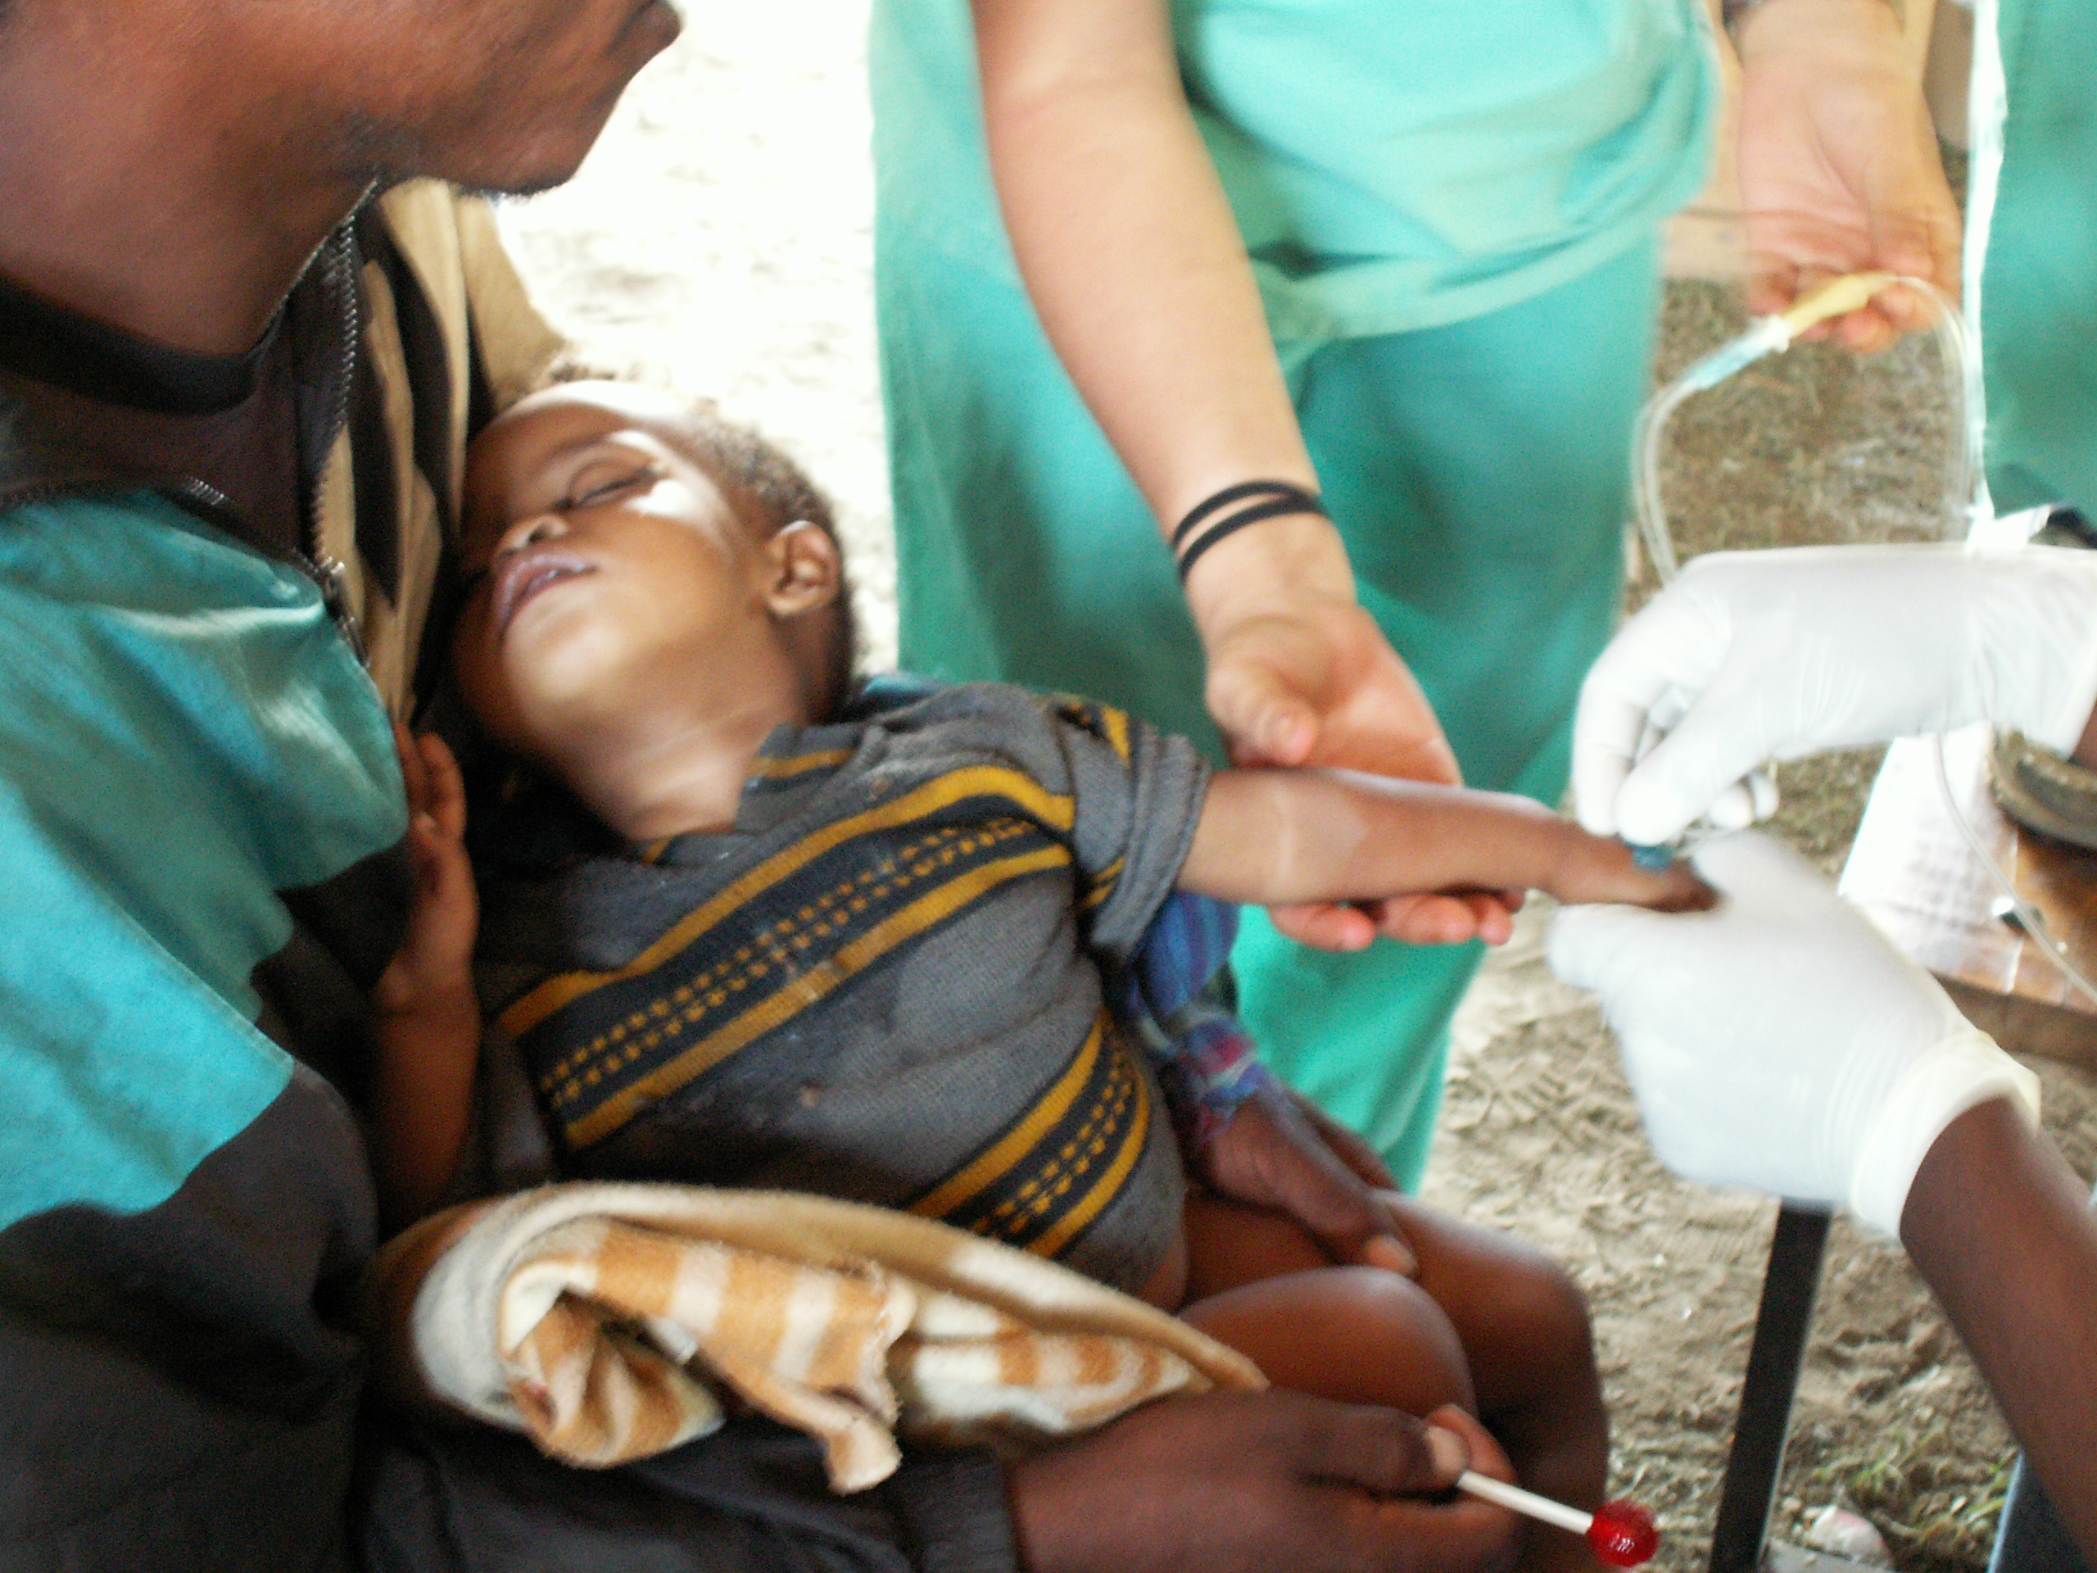
Sustainable Development UNITY
GEOGRAPHIC FOCUS:
Latin America—Africa—Asia—Native American Nations
HEART PROGRAMS:
EDUCATION
ENTERPRISE
ENVIRONMENT
HEALTH
TECHNOLOGY
MARRYING SIMPLE & MODERN TECHNOLOGY
“We cannot be separated
in interest
or divided in purpose.
We stand together….”
- Woodrow T. Wilson

Slide 6
Sustainable Development unity
UNITED epic HEARTS + $ =
BRINGING OUT THE BEST IN OUR SHARED HUMANITY!
OUR HEART Programs support the United Nations
17 Sustainable Development Goals
What is the #1 goal?: NO POVERTY

Slide 7
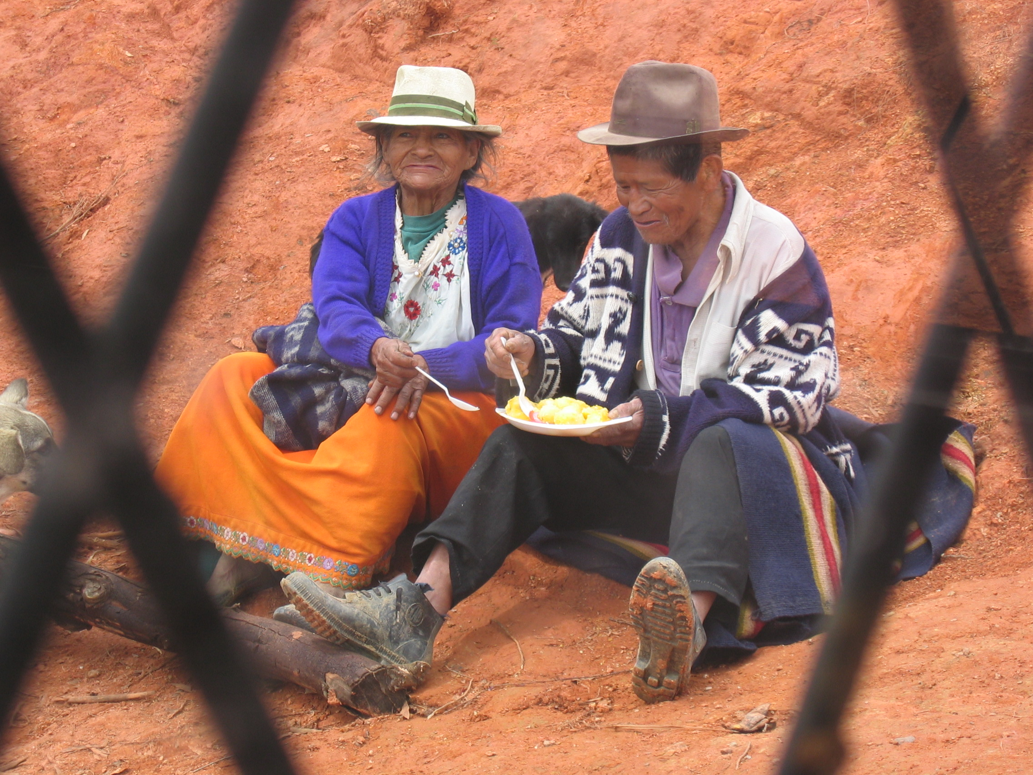
Background
“Our history speaks for itself
as we have been able to change
millions of lives.”
-- Carrie Grow
History, Present, Future
Andean Children’s Foundation (1982)
CHOICE Humanitarian (1987)
Engage Now Foundation (2000)
Ascend Alliance (2005)
epic HEART adventures (2022)

Slide 8
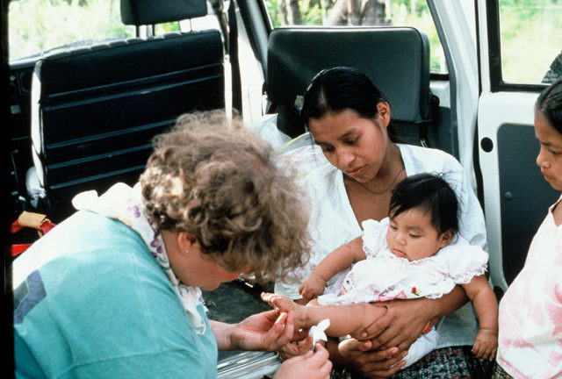
HEART Programs
EDUCATION
Employing BEST PRACTICES in Sustainable Education Facilities, Teaching & Training, including LSC: Literacy for Social Change & CIS: Counseling in the Streets, with Indigenous Education Ambassadors + On-line Mentoring = Indigenous Families INSPIRED to STUDY, LEARN, LOVE & SERVE
The foundation
of success in life
is good health….”
- P.T. Barnum

Slide 9
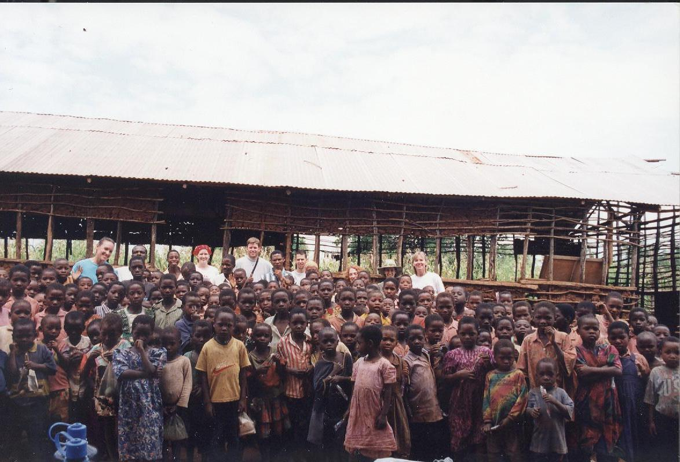
HEART Programs
ENTERPRISE
Employing BEST PRACTICES in Sustainable Education Facilities,
Teaching & Training, including LSC: Literacy for Social Change & CIS:
Counseling in the Streets, with Indigenous Education Ambassadors + On-line
Mentoring = Indigenous Families INSPIRED to STUDY, LEARN, LOVE & SERVE
“Education is not preparation for life;
education is life itself.” - John Dewey

Slide 10
HEART Programs
EDUCATION
Employing BEST PRACTICES in Sustainable Education Facilities,
Teaching & Training, including LSC: Literacy for Social Change & CIS:
Counseling in the Streets, with Indigenous Education Ambassadors + On-line
Mentoring = Indigenous Families INSPIRED to STUDY, LEARN, LOVE & SERVE
“Education is not preparation for life;
education is life itself.” - John Dewey

Slide 11
HEART Programs
EDUCATION
Employing BEST PRACTICES in Sustainable Education Facilities,
Teaching & Training, including LSC: Literacy for Social Change & CIS:
Counseling in the Streets, with Indigenous Education Ambassadors + On-line
Mentoring = Indigenous Families INSPIRED to STUDY, LEARN, LOVE & SERVE
“Education is not preparation for life;
education is life itself.” - John Dewey

Slide 12
HEART Programs
EDUCATION
Employing BEST PRACTICES in Sustainable Education Facilities,
Teaching & Training, including LSC: Literacy for Social Change & CIS:
Counseling in the Streets, with Indigenous Education Ambassadors + On-line
Mentoring = Indigenous Families INSPIRED to STUDY, LEARN, LOVE & SERVE
“Education is not preparation for life;
education is life itself.” - John Dewey

Slide 13
HEART Programs
EDUCATION
Employing BEST PRACTICES in Sustainable Education Facilities,
Teaching & Training, including LSC: Literacy for Social Change & CIS:
Counseling in the Streets, with Indigenous Education Ambassadors + On-line
Mentoring = Indigenous Families INSPIRED to STUDY, LEARN, LOVE & SERVE
“Education is not preparation for life;
education is life itself.” - John Dewey

Slide 14
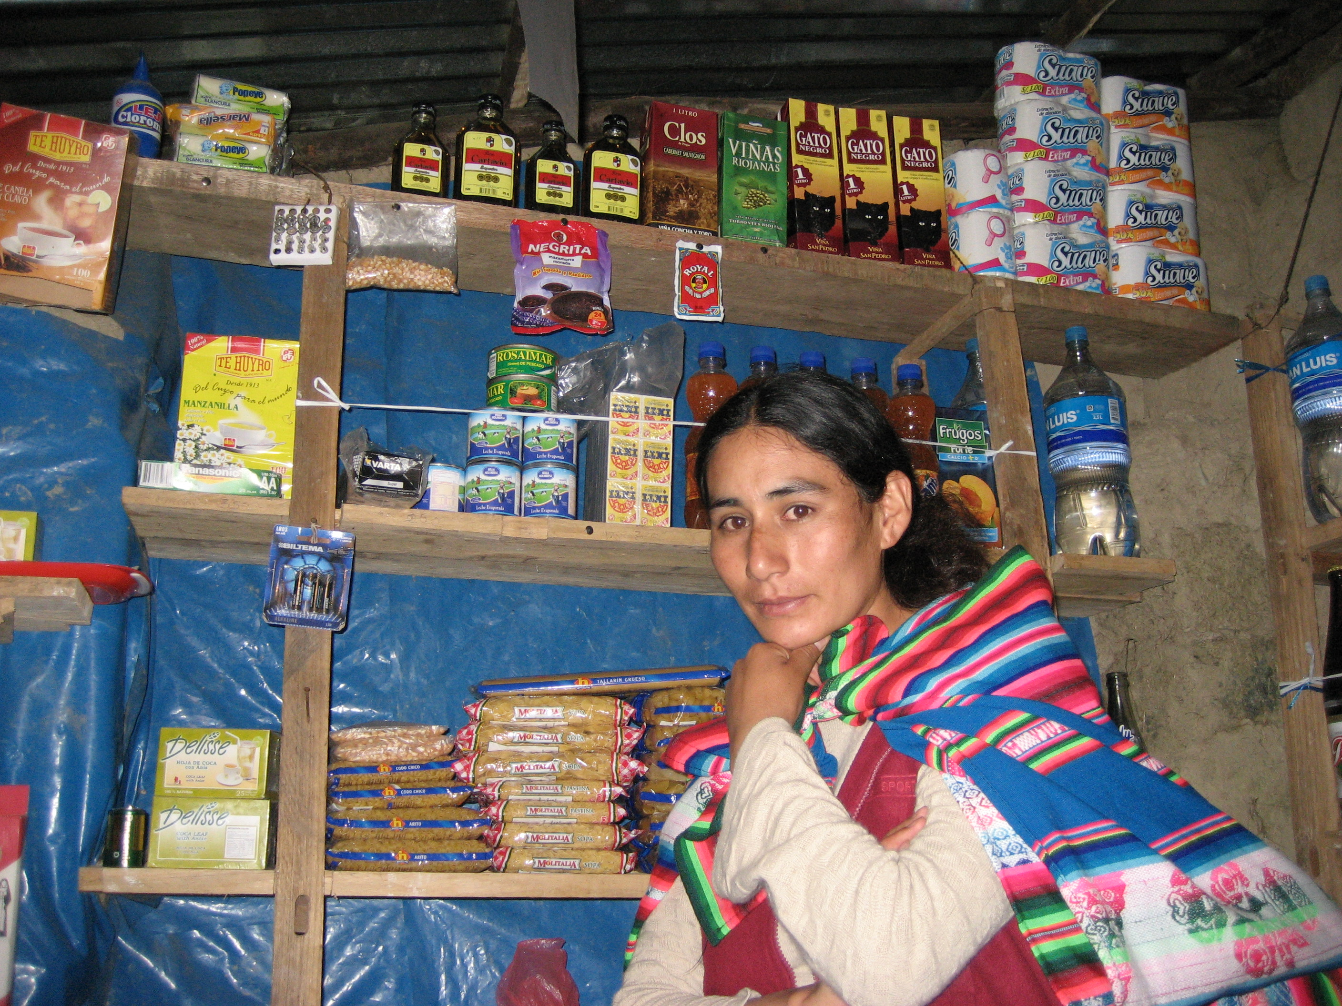
Program ACCOMPLISHMENTS
ENTERPRISE
SPECIFIC PROGRAM INFO TO BE ADDED
“When women work, they invest 90 percent of their income back into their family, compared with 35% for men. So Narnia Programs focus on women & children.”
- Carrie Grow

Slide 15
Program ACCOMPLISHMENTS
ENVIRONMENT
SPECIFIC PROGRAM INFO TO BE ADDED
“A nation that destroys its soil destroys itself,
Forests are the lungs of our land.”
- Frandlin D.
Roosevelt

Slide 16
Program ACCOMPLISHMENTS
TECHNOLOGY
SPECIFIC PROGRAM INFO TO BE ADDED
“ Appropriate Simple technology is sustainable, easily repaired and/or replaced by local villagers.”
- Carrie Grow
“ Any sufficiently advanced technology is equivalent to magic.”
- Arthur C. Clarke (Author)

Slide 17
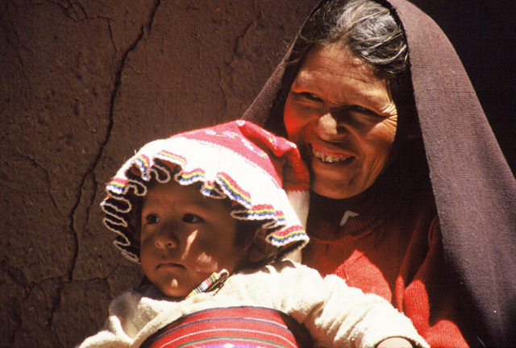
What Makes Epic HEART Unique?
Funding Paradigm: 100% of donations go to programs
Admin & fundraising costs covered by Epic HEART Adventures LLC
Partnering Focus for Optimal Impact
Internship / Fellowship Program
Faith-based, non-denominational

Slide 18
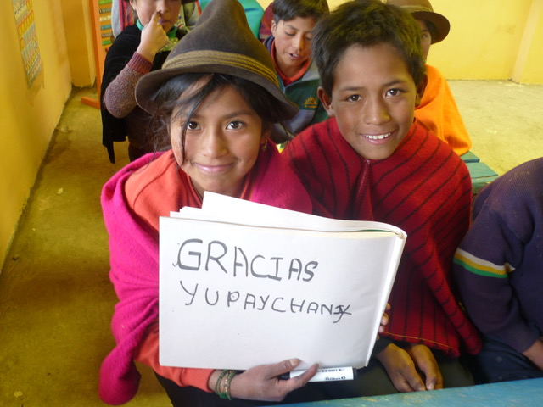
Program Goals
Financial / Impact Goals
2030: $1 Billion to programs impacting millions of lives through grassroots development and expeditions, with Smart Partners, leadership interns and fellows.
2040: Largest United Global Impact / $ Invested in Programs such that Project U-GIP makes a Major Impact on Global Poverty and in Cross-Cultural Understanding .
“Believe you can
and you’re
halfway there”
- Theodore
Roosevelt

Slide 19
Program ACCOMPLISHMENTS
EDUCATION
SPECIFIC PROGRAM INFO TO BE ADDED

Slide 20
Organizational CHART
Narnia Foundation
501c3 PARENT ORG
7-Member
Board of Directors
Narnia Endowment
501c3 Supporting Org
Narnia Expeditions
501c3 Supporting Org
Advisory Board:
Executive Advisors, Specialists &
Intern Mentors
5 Board Members
7 Board Members
Advisory Board:
Executive Advisors & Specialists
Advisory Board:
Executive Advisors, Expedition Leaders & Specialists
“At the end of life we will not be judged by how many diplomas we have received,
how much money we have made, how many great things we have done.
We will be judged by “I was hungry, and you gave me something to eat, I was naked and you clothed me.
I was homeless, and you took me in.” - Mother Teresa

Slide 21
DreamTeam CHART
Chair: Carrie Grow
Board Vice Chairs
CEO: Darol Wagstaff
Executive Assistant
Jan Robbins
Office Manager: TBD
Field Operations GM
Production & IT Director
Marketing Director
Field Operations Sustainable Development Director
Interns
Interns
Advisory Board:
Executive Advisors & Specialists
Advisory Board:
Executive Advisors & Specialists
Exped. Leaders & Field Interns
Executive Advisors, Specialists
& Field Intern Mentors
“You are uniquely qualified to be a pencil in the Hand of Diety. You probably know the idea comes from Mother Theresa… Who often referred to herself as a “pencil in the hand of God,”
(who sometimes got dull… and then God sharpened her up again).” - Carrie Grow

Slide 22
Annual Retreat & Gala: epic HEART Adventures
“The biggest strength of humankind lies in unwavering unity.”
- Carrie Grow
Annual Face to Face Board Meetings for Combined Board (Semi-Annual Board meetings will be held virtually by Zoom)
Annual Round Table Discussions, Training Seminars, Expedition Reunions & Gala to:
UNITE Like-Minded Charities with
Foundations, Corporations, Governments & Individuals
2. Raise Funds to Employ Smart Sustainable Development &
Life-Changing Expeditions to achieve
3. United-Global Impact on Poverty
Simple Mission Formula in Action: 1+2=3

Slide 23
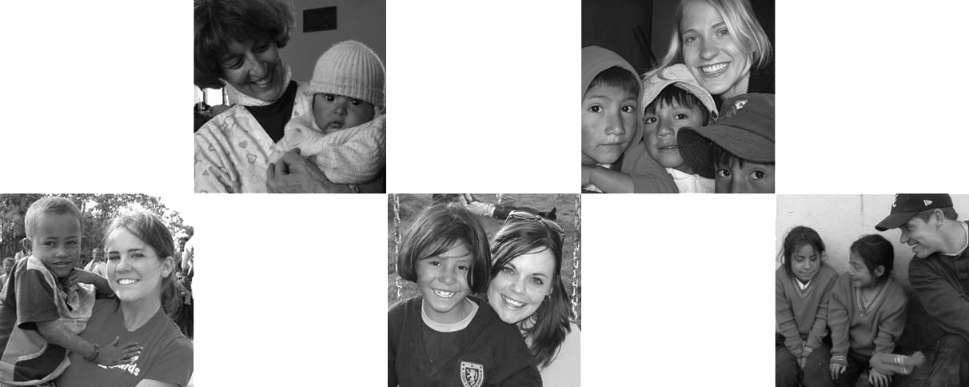
Epic HEART Adventure FOUNDATION
SMART SUSTAINABLE DEVELOPMENT
Uniqueness
Global partnerships enable optimal results: Partnering with Other Organizations = Best Practices , Economies of Scale, Leveraging Resources, Higher Success Rate & Sustainability
Infusing sustainable development with world-class, life-changing expeditions enhances beneficiary involvement, global understanding and self esteem
“There is no reason to re-invent the square wheel.
Let’s capitalize on strengths and address
global poverty in a United, Intelligent way,
so that we can successfully change the world --Together!” - Carrie Grow

Slide 24
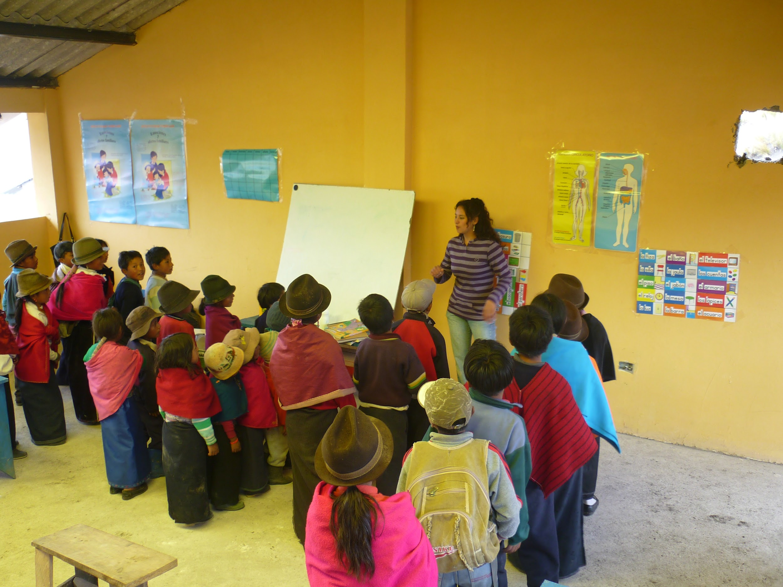
Epic HEART Adventures FOUNDATION
SMART SUSTAINABLE DEVELOPMENT
In-Country “Global HEART (Smart) Partners”
Rather than spend resources maintaining in-country staff, EHA partners with outstanding organizations on the ground, in the countries we serve.
Instead of duplicating efforts, we support existing organizations to become stronger, more effective and able to do more with their resources and ours through partnership.
We affectionately refer to our in-country teams as global HEART partners.
“Life must be reinvented!
A mass elevation of the senses is of need….
This was God’s intention.”
- Isbelle Razors

Slide 25
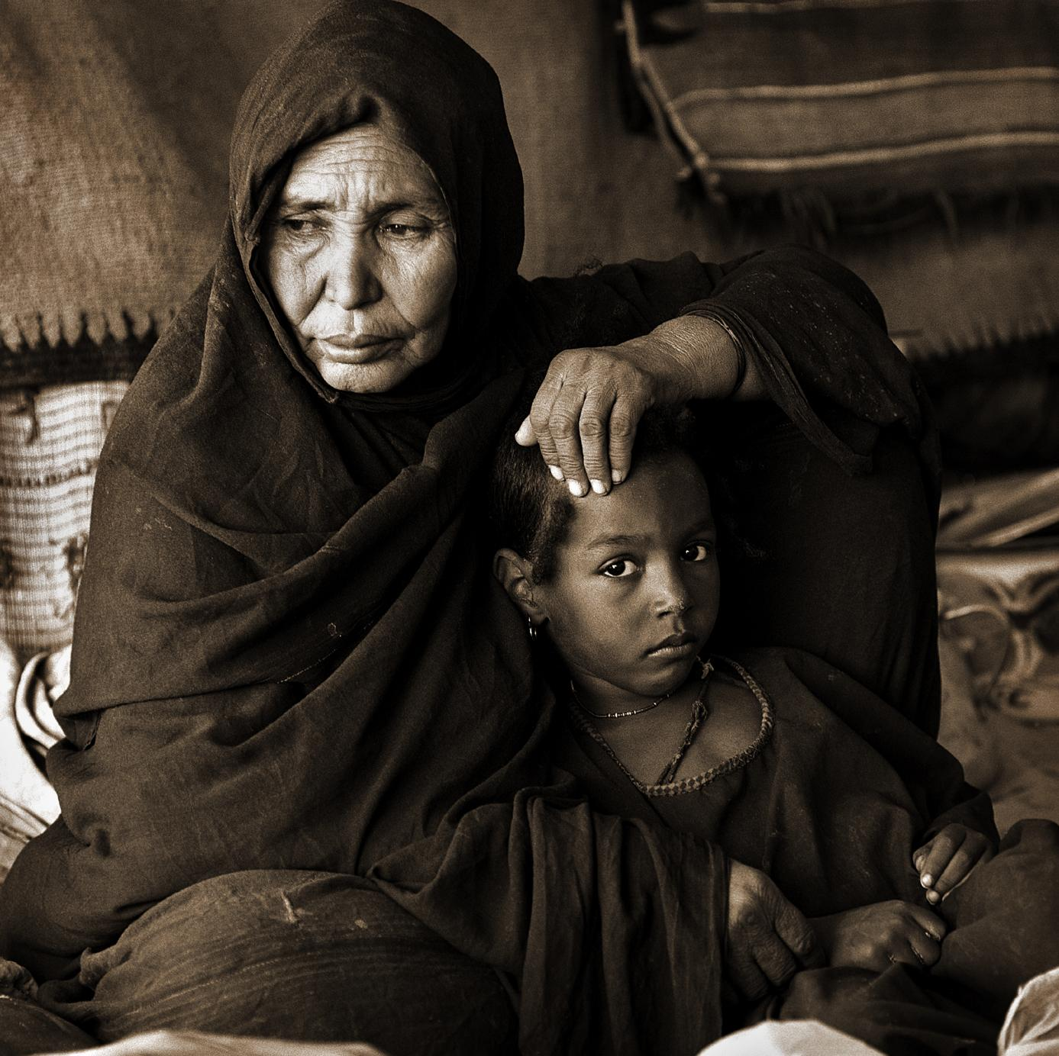
Epic HEART Adventures
Partnerships
Partner Charities & Non-Profit Organizations - global and U.S.-based
Partnering Communities, Governments & Agencies
Narnia Expeditions (supporting org.)
Narnia Endowment (supporting org.)
Narnia TV and other Narnia For-profit entities
Carrie Grow Development & Carrie Grow Trust
Waterfall Global & Partnering Corps./Orgs.
Additional Corporations, Foundations, Orgs. & Individuals
“It always seems impossible
until it’s done.”
– Nelson Mandela

Slide 26
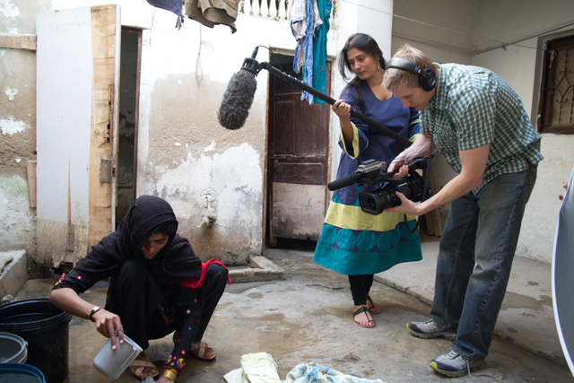
Epic TV! Lights, Camera, Action!
Epic HEART Adventures, Immersion Media &
Crossman Post Production Collaboration
Weekly episodic television unites humanitarian outreach, adventure sports and charities. Commercial distribution puts Narnia Foundation in the global spotlight.
Unique and new reality television series
Profiles charities & beneficiaries each episode
Free advertising for profiled charity / foundation along with selected participant(s)
Participant(s) and CEO Interaction with world- famous adventure athletes in impoverished countries / communities
Life-transformational humanitarian theme, compelling, touching story line and outcomes!
Initial episodes will likely be “special features,” then develop into a weekly series.

Slide 27
HEART EXPEDITIONS
“Two roads diverged in a wood…
I took the one less traveled by,
and that has made all the difference.”
--Robert Frost
Uniqueness
Humanitarian Projects + Unique Culture + High-Adventure = An “Off-the-Charts” Experience… World-class, Life-Changing Adventure!
Partnering with Other Organizations = Best Practices , Economies of Scale, Leveraging Resources, Higher Success Rate & Sustainability
Self-funding expeditions also lead to long-term funding & development

Slide 28
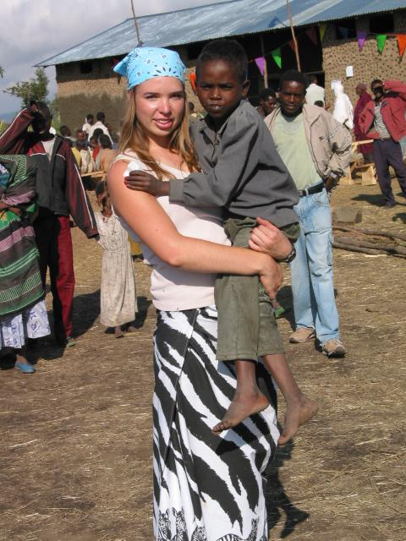
HEART EXPEDITIONS
“If we treat our children
and our grandchildren
as though they are
already compassionate, amazing human beings
...they may in fact
become such!”
--Carrie Grow
Why Go on an Adventure with Narnia?
Choose to give thanks for blessings through service to those less fortunate.
Help “save” the next generation from becoming spoiled and entitled. One of the greatest gifts we can give our children and grandchildren is to help them understand their place in the world and how truly blessed they are!

Slide 29
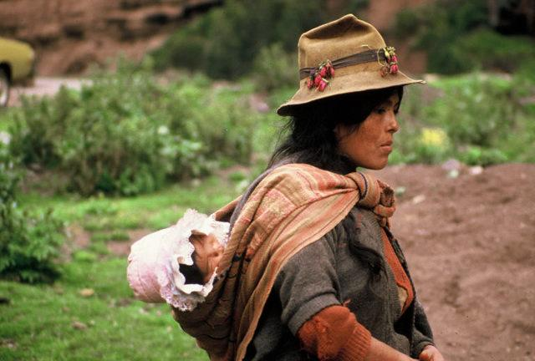
HEART EXPEDITIONS
About Expeditions….
“Open Expeditions” are available for all to consider, from age 8 to 108. Participants come from various walks of life and backgrounds including individuals, couples, families, grandparents & grandchildren, etc.
Expeditions are faith-based, non-denominational, life-changing adventures!
Diversity of Faith = increased global understanding
“Do not go where the path may lead,
go instead where there is no path
and leave a trail.””
--Ralph Waldo Emerson

Slide 30
EHA EXPEDITIONS
“Do not go where the path may lead,
go instead where there is no path
and leave a trail.””
--Ralph Waldo Emerson
Custom Adventures
“Custom Expeditions” can be arranged for groups of 10 to 100 in order to meet the specific needs/ desires of corporate & organizational retreats and team-building, family reunions, etc.
These expeditions may be to locations other than Latin America and Africa .

Slide 31
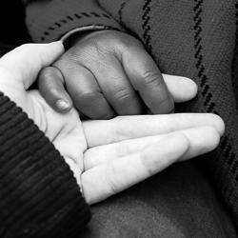
EHA EXPEDITIONS
An Example of a Custom Expedition
being considered with Waterfall Global
Native American Cultures
Culture Preservation
Generational Ecological Awareness/Projects
Cross-Cultural Understanding
Other Projects as Identified with Communities
Boundary-Pushing Adventure Expeditions:
Specialized Military-Style Training
Crow Reservations: Hunting, Fishing, etc.
Others (TBD)
“You only live once,
but if you do it right,
once is enough.”
- Mae West

Slide 32
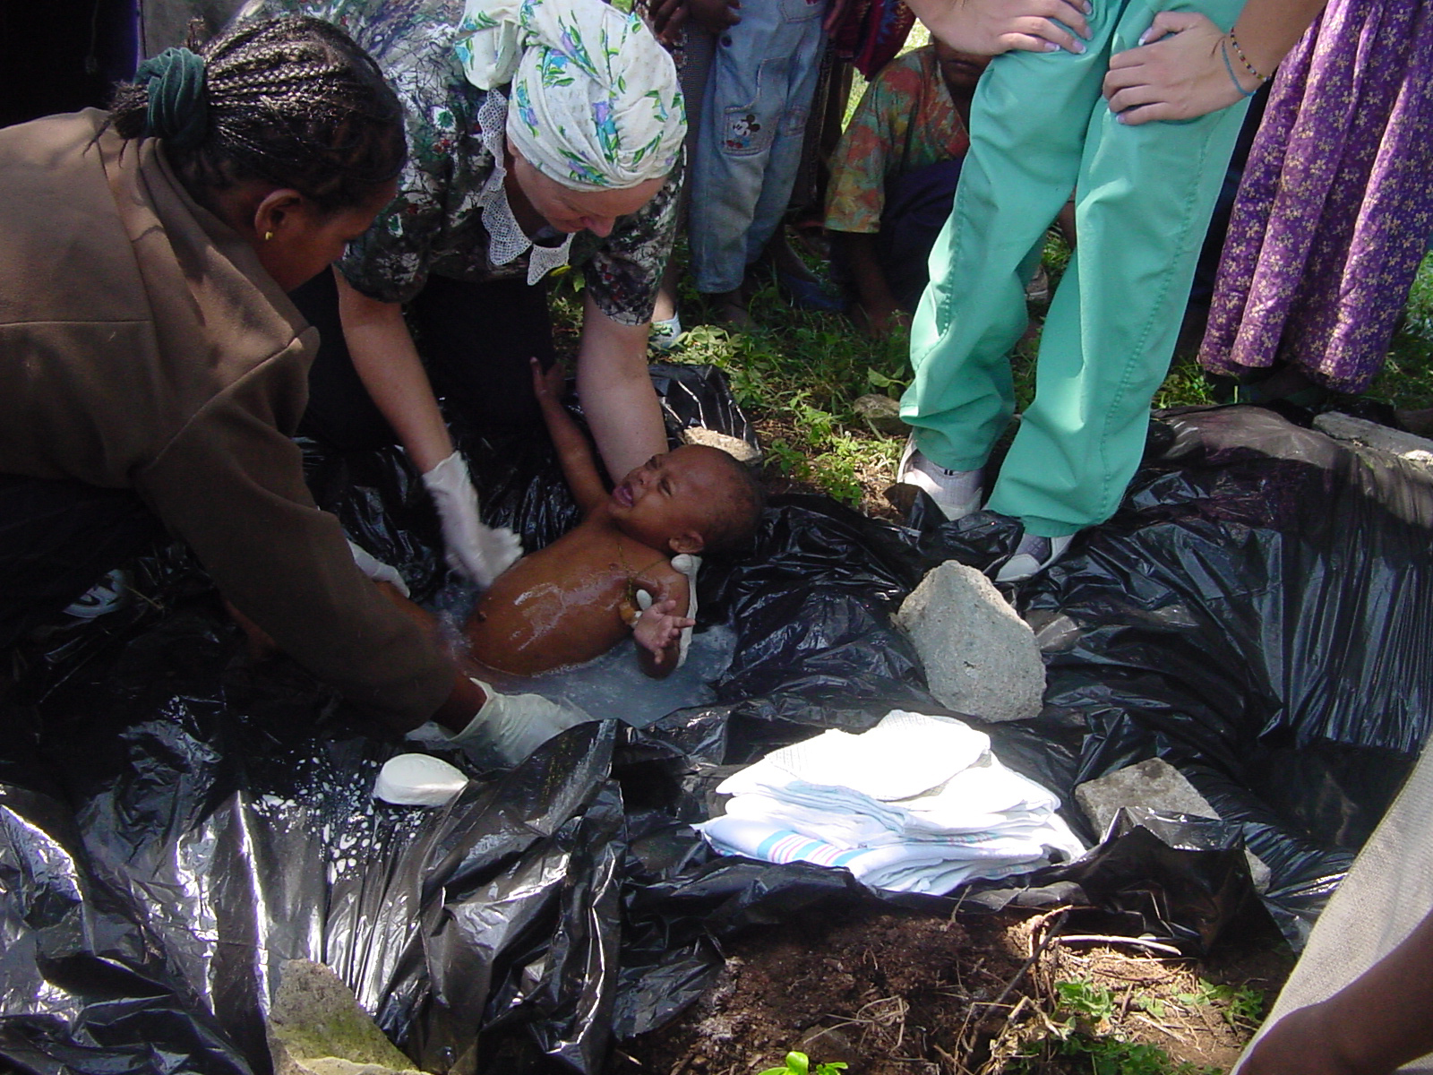
EHA EXPEDITIONS
SAFETY FIRST AND FOREMOST!
Narnia organizers have 38 years of experience handling ”COVID-like” situations.
Developing Countries have long required vigilant safety & health precautions.
Narnia Expeditions offer the safest travel experience you can choose!
All participants test for COVID within the week prior to departure.
“We now consider Developed Countries to have similar challenges to what Developing Countries have suffered for centuries!
We are vigilant about safety & health.”
--Carrie Grow

Slide 33
EHA EXPEDITIONS Unique Humanitarian Opportunities + Tours & Epic Adventures
Humanitarian – Deductible
Expeditions are designed to
enhance Smart Sustainable
Development in:
Education
Enterprise
Environment
Health
Technology
Cultural Tours & Extended Adventures – Non tax deductible
Short (3 days)
Suitable for everyone
moderate recreation
Extended (additional 3 days to 1 week)
Fit, Adventurous People
Boundary-Pushing, Epic Experiences
"The best path in life is seldom the easiest!” - Carrie Grow

Slide 34
Expedition Growth - TIMELINE
“Keep Your Eyes on the Stars and Your feet on the Ground” – Theodore Roosevelt
2022: 6 Expeditions
3 to Native American Nations Ecuador, Peru and Bolivia
1-Christmas Expedition to Guatemala
2022: 10 Expeditions
2 - Open Expeds to Latin America
2 - Open Expeds to Africa
2 - Waterfall
3 - Other Corps./ Orgs./ Foundations
2023: 25 Expeditions
8 – Open Expeds to Latin America & Africa
3 -Waterfall s. / Orgs. / Foundation
2024 and beyond: 50+ Expeditions
15 - Open Expeds to Latin America & Africa
5 -Waterfall
30 -Other Corps. / Orgs. / Foundations

Slide 35
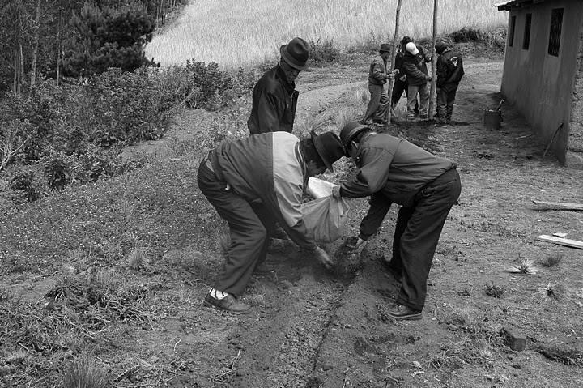
Legacy ENDOWMENT
History, Present, Future
Engage Now Endowment (2000)
Ascend Endowment (2005)
EHA Legacy Endowment (2022)
Uniqueness
Separate 501c3 Organization
10% of all donations received by EHA go into the Endowment
Fund Cornerstones are business & individual partners including Fund for Sustainable Development, Carrie Grow Real Estate, the Carrie Grow Trust and for-profit EHA enterprises
Growth from Additional Corporate and Organizational Partners
“You have not lived today
until you have done something
for someone who can never repay you.”
– John Bunyan

Slide 36
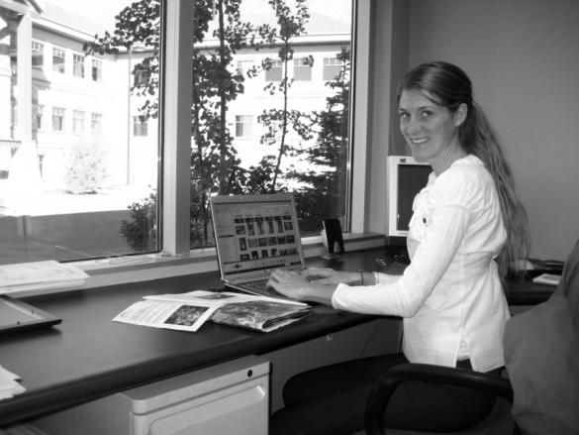
Internship & MENTORSHIP PROGRAM
“The delicate balance of mentoring someone is not creating them in your own image,
but giving them the opportunity to create themselves.” – Steven Spielberg
History, Present, Future
Interns have served as Volunteer Leaders since 1982.
All U.S.-based interns are compensated $15 hour to be paid to their University to cover any eligible education expense, including tuition, books, fees, housing, etc.
Students mentored by staff, fellow, board & advisors. Each student intern will be assigned a one-on-one volunteer mentor, well-suited for the student’s planned profession. Mentors are part of the Foundation Advisory Board.
Uniqueness
Students and Fellows fulfill important staff and field operations roles
Opening doors for employment opportunities with partnering organizations

Slide 37
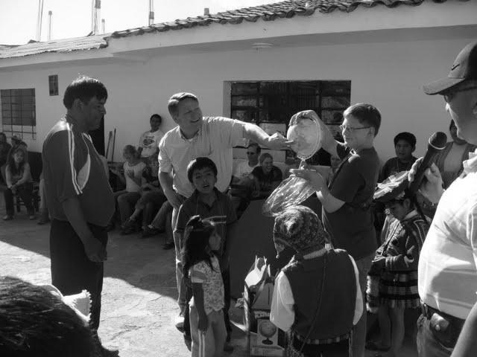
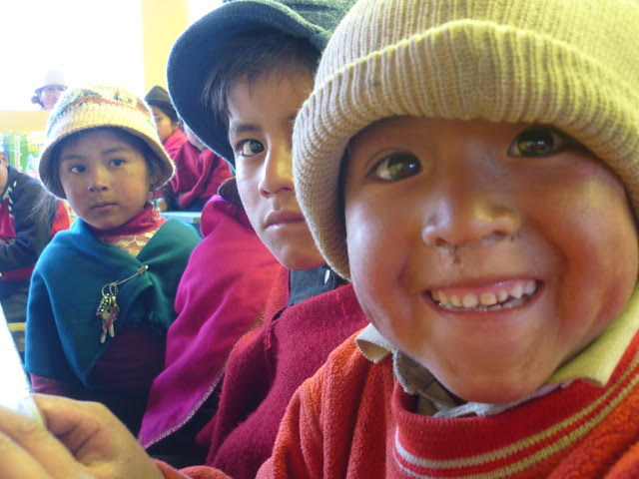
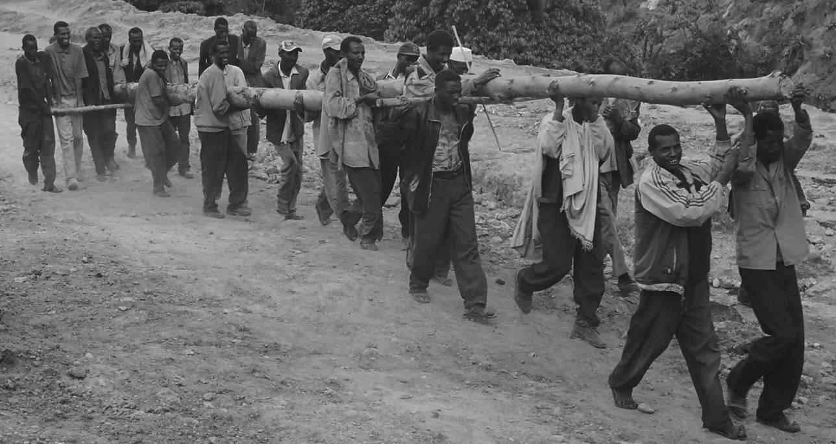
Interns and Mentors GROWTH
2023: 10 Interns, 10 Mentors
2024: 25 Interns, 25 Mentors
2025: 50 Interns, 50 Mentors
2026 and beyond: 100+ Interns, 100+ Mentors
“If you get, Give,
if you learn, Teach.”
– Maya Angelou

Slide 38
Fellowship PROGRAM
“Retirement is an opportunity to give back…
It isn’t the end of the road, it’s the beginning of new adventures.”
– Carrie Grow
History, Present, Future
Fellows have served with Narnia predecessor organizations as Volunteer Leaders since 1992.
Fellows are generally retirees who have time to serve part or full time in a Volunteer Leadership capacity. They have customized leadership roles.
Leadership opportunities include serving overseas in a specific geographic area full time; overseeing countries of geographic focus full or part time i.e. Ecuador, Bolivia, Peru, Paraguay, Guatemala, Mexico, Ethiopia, Kenya, Tanzania, Ghana, Nigeria or Mozambique…with more to be added over time; or fellows also oversee specific program areas in health, education, micro enterprise or environment.

Slide 39
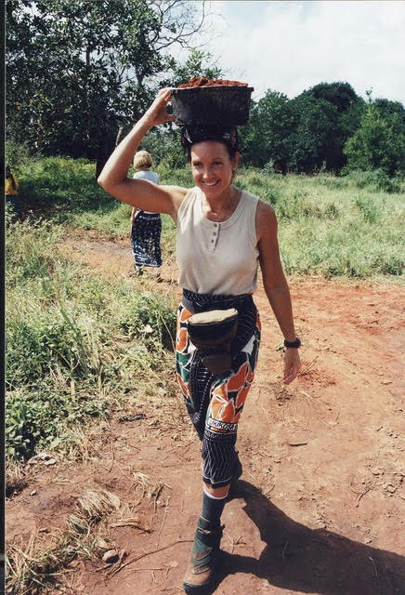
Carrie Grow, CHAIR / CEO
Global Humanitarian Operations
President, CEO, Co-Founder, Ascend Alliance, Engage Now, & Epic Heart Adventures. U.S. Based Humanitarian Organizations with programs in Africa & Latin America
CEO, CHOICE Humanitarian & Andean Children’s Foundation - U.S. Based with projects in Africa, Asia & Latin America
Administrator of the Year Award, Romney Institute, BYU
Freedom’s Foundation Heroes Award
Business
Owner / President, Carrie Grow Real Estate, specializing in Destination Adventure Resorts
Co-Owner, Development Source: Real Estate Development, Property Management & Consulting
President, Intermountain Publishing & VP, Abiline Publishing
Franchisee of the Year, International Franchise Association, Infinite Solutions Consulting - Schooley Mitchell Telecom
Kier Corporation Board of Directors & Consultant – Construction, Real Estate Development & Property Mgmt.
GFC Board of Directors, 1000 acre Real Estate Development
Utah Business Magazine: One of 30 Business Women to Watch
Arts & Religion
Development Director, Utah Opera
Concertmaster and Soloist with various Symphony Orchestras
Founder, Grow Violin School
Natl. Championship Forensic Mgr.
State Sterling Scholar, Speech & Drama
Harvard Religious Studies
Political
National Harry S. Truman Scholar
Utah Republican Party: Executive Director, Finance Director, Consultant
Directed & raised funds for national & local campaigns & events, including U.S. Presidents, Vice Presidents and First Ladies
Development Director, Congressional Challenge Golf Tournament
Cabinet Member, Boys / Girls Nation; Senator, Girls State

Slide 40
COO or Co Directors: Adventure & Mission
JOB DESCRIPTION HIGHLIGHTS:
Critical Skills Sets and Personality Attributes include:
Passion for Mission
Exemplary Leadership & Maturity
Problem solving and negotiating skills
Creativity
Quick thinking & calm focus amid storms
Deep Faith in a Bright Future in spite of global challenges
A humanitarian heart that recognizes all Nationalities and Backgrounds as healthy diversity and awesome creations made possible by a loving higher power
Patience offset with tenacity
Unshakable positivity amid tough realities
Excellent mentoring and delegating skills
Solid Multi-tasking and organizational skills
Executive whose life and accomplishments reflect a servant-leader model
Not afraid to get in the “trenches” and do whatever it takes to succeed
Humility: Willing to set her / his ego aside – self-absorbed candidates not an option
Leadership Experience:
10+ years of international experience
10+ years of business or Military leadership experience
Educational Background
Appropriate Masters Degree coursework or equivalent life experience
Hiring Process & Compensation Information
Applications close July 10
Selection and hiring complete July 15, 2022
Position begins Sept 1, 2022
Salary & incentives negotiable
Joy in the Journey of Service is also paramount, as is a solid work ethic
Money should not and cannot be the primary motivator.

Slide 41
CMO (or Co-Marketing Directors)
JOB DESCRIPTION HIGHLIGHTS:
Critical Skills Sets and Personality Attributes include:
Passion for Mission
Exemplary Leadership & Maturity
Problem solving and negotiating skills
Creativity
Quick thinking & calm focus amid storms
Deep Faith in a Bright Future in spite of global challenges
A humanitarian heart that recognizes all Nationalities and Backgrounds as healthy diversity and awesome creations made possible by a loving higher power
Patience offset with tenacity
Unshakable positivity amid tough realities
Excellent mentoring and delegating skills
Solid Multi-tasking and organizational skills
Executive whose life and accomplishments reflect a servant-leader model
Likely candidates include Nathan Osmond
Not afraid to get in the “trenches” and do whatever it takes to succeed
Humility: Willing to set her / his ego aside – self-absorbed candidates not an option
Leadership Experience:
10+ years of business or Military leadership experience
Educational Background
Appropriate Masters Degree coursework or equivalent life experience
MPA or MBA preferred
Hiring Process & Compensation Information
Online application will be live on the Narnia Foundation website as of October 1, 2020
Applications close : July 10
Screening and Interviews July 15 Oct 15-18
Selection and hiring complete July 15, 2022
Position begins October 1, 2022
Salary & incenticvews negotiable
Joy in the Journey of Service is also paramount, as is a solid work ethic
Money should not and cannot be the primary motivator.

Slide 42
Director of Productions: John Crossman
JOB DESCRIPTION HIGHLIGHTS:
Critical Skills Sets and Personality Attributes include:
Passion for Mission
Exemplary Leadership & Maturity
Problem solving and negotiating skills
Creativity
Quick thinking & calm focus amid storms
Deep Faith in a Bright Future in spite of global challenges
A humanitarian heart that recognizes all Nationalities and Backgrounds as healthy diversity and awesome creations made possible by a loving higher power
Patience offset with tenacity
Unshakable positivity amid tough realities
Excellent mentoring and delegating skills
Solid Multi-tasking and organizational skills
Executive whose life and accomplishments reflect a servant-leader model
Not afraid to get in the “trenches” and do whatever it takes to succeed
Humility: Willing to set her / his ego aside – self-absorbed candidates not an option
Leadership Experience:
10+ years of business and Production leadership experience
Educational Background
Appropriate Masters Degree coursework or equivalent life experience
Hiring Process & Compensation Information
Position began May 2022
Joy in the Journey of Service is paramount, as is a solid work ethic
Money should not and cannot be the primary motivator.

Slide 43
Funding GOALS
“I AM THE FIRST EXECUTIVE ADVISOR FOR EHA: ALREADY DONATING $750,000+
I am also setting aside 50% of my Carrie Grow Trust for EHA, so that when I die in 40 years or so, I will have done
as much as I possibly can to make certain EHA has a multi-billion dollar endowment fund. – Carrie Grow
CHANGE THE WORLD SOCIETY OF $50,000,000
➤ 75 members by 2030
EXECUTIVE ADVISORS CLUB
DONORS OF $500,000+
➤ 500 members by 2025
ENDOWMENT FUND GOALS
➤ $50 million by 2030
SMALLER DONATIONS ADD UP TO MAKE A MAJOR IMPACT!
Donations of $25 TO $250,000 are incredibly important as we progress!
➤ 5000 smaller donations per year

Slide 44
epic HEART ADVENTURES
ENDING GLOBAL POVERTY BY 2040
This is no longer the “IMPOSSIBLE DREAM”:
THIS DREAM IS NOW OUR MISSION

Slide 45
epic HEART ADVENTURES
ENDING GLOBAL POVERTY BY 2040
“I feel incredibly blessed to know who I Am and what
My Mission is in this Life… So returning to John Lennon…
“We Hope You’ll Join Us!” – Carrie Grow
“I have no regrets because I know
I did my best - all I could do.”
– Midori Ito

